Slide 1




Time Series Analysis of Covid Impact on the UK, SWEDEN and AUSTRALIA
Authors
MoureenCaroline Ochieng| Sophie Burroughs | Chiratidzo Matowe | Oluboye Pelumi | Chang Xu | Anna Lisowska

Slide 2

Agenda:
Introduction
Cleaning data
Analysis 1,2,3
Summary

Slide 3


Introduction
One disease and three approaches. Varying levels of restrictions:
lenient approach - Sweden
medium approach - United Kingdom
very restricted - Australia
Data sources: &

Slide 4
Data Preprocessing
Data Cleaning Techniques:
Renaming column
Handling missing values
Handling duplicates
Data merging

Slide 5

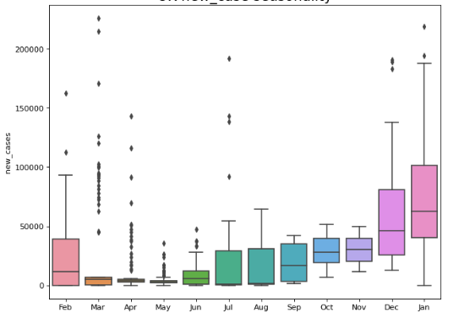
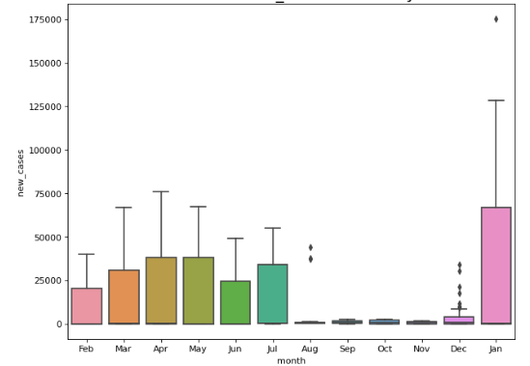
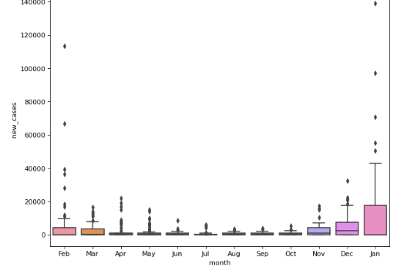
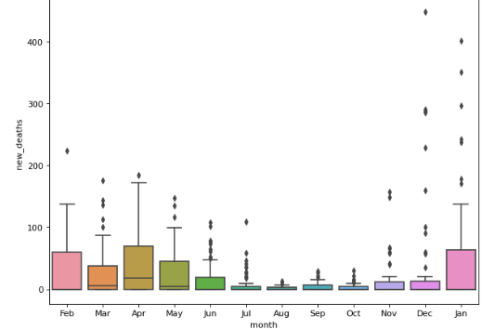
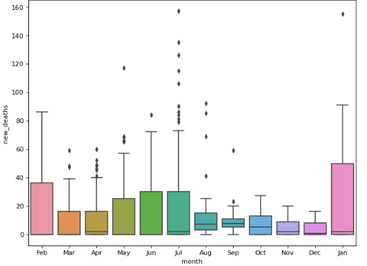
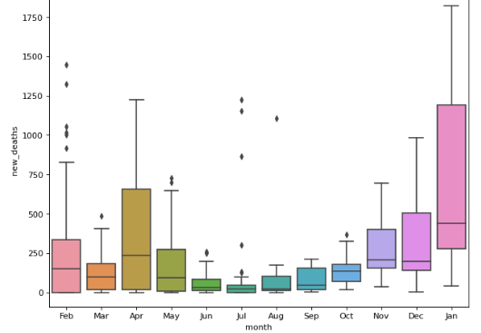
Time Series Analysis-understand month seasonality
United Kingdom
Sweden
Australia
Notes:
As three countries adapt different lockdown policies. To understand the seasonality difference in the country.
Will there be any difference in the case growth grow pattern and correlation between death growth and case number growth
The diagram of the all the cases in all three country
Box-polt of each country new case and new death:
Each country presents different seasonality in case of growth and death growth.
The distribution of UK, Australia new deaths and new cases is aligned.
All have higher death numbers and new cases in January and February even though in Australia it is summer.
Conclusion: there is other factors impact the covid case grow and new death in different factors

Slide 6
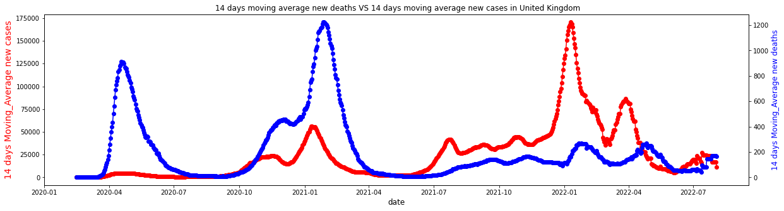
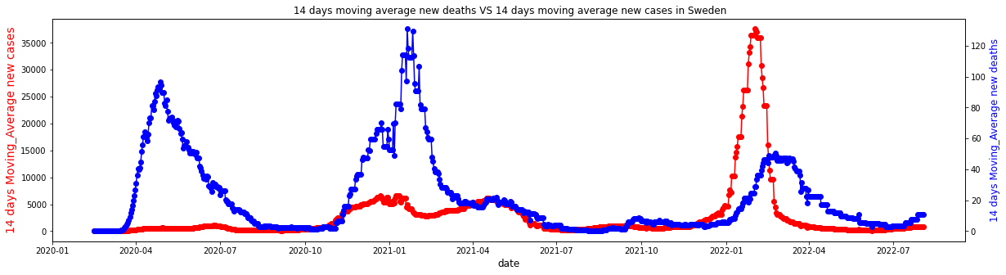
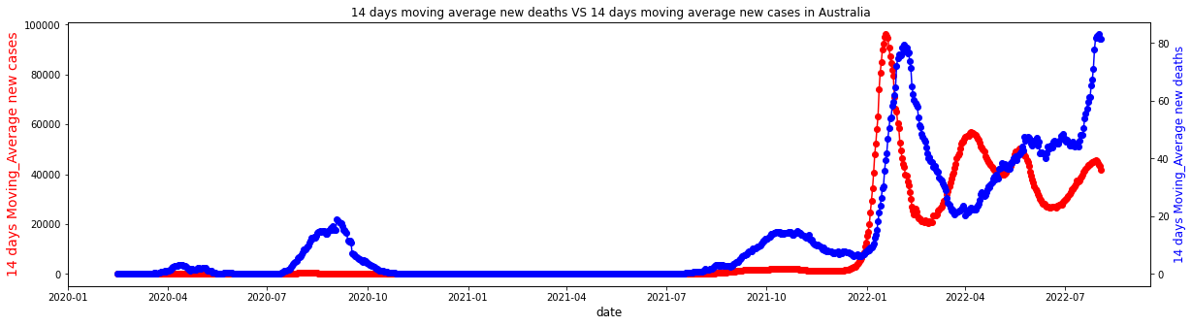
Time Series Correlation Analysis
Time Period | Correlation | Total Case | Total Death | Death Rate
Stage one | 45.56% | 2777604 | 76365 | 2.75%
Stage two | 16.19% | 22620574 | 181177 | 0.80%
U
K
Time Period | Correlation | Total Case | Total Death | Death Rate
Stage one | 39.97% | 469747 | 9217 | 1.96%
Stage two | 27.92% | 2539714 | 19614 | 0.77%
S
W
Time Period | Correlation | Total Case | Total Death | Death Rate
Stage one | 84.64% | 28524 | 910 | 3.19%
Stage two | 88.61% | 9583856 | 11763 | 0.12%
AU
Notes:
Lock down procedure is highly correlate with the curb the case growth thus impacted the death rate. So is there any correlation between the Death and people get impacted.
Step 1: stationary the time series into 14 days moving average time series
Step 2: Separate the data with two stage: stage one: where is no vaccine 2020 02 to 2021 01
There is lag between the new case growth and new deaths. Therefore I lag the new cases column based on the figure provided on https://assets.publishing.service.gov.uk/government/uploads/system/uploads/attachment_data/file/928729/S0803_CO-CIN_-_Time_from_symptom_onset_until_death.pdf
Stage 1: No vaccine when the virus first identified:
There is no correlation between the death and cases be identified in UK and Sweden
Based on the observation more death was observed compared to the people get infected
Stage 3: The introduce of the vaccine
There is a strong correlation that can be observed in Australia. The death rate is higher than the other countries in the first stage.
The death rate is lower than second stage is lower while the vaccine being imposed

Slide 7
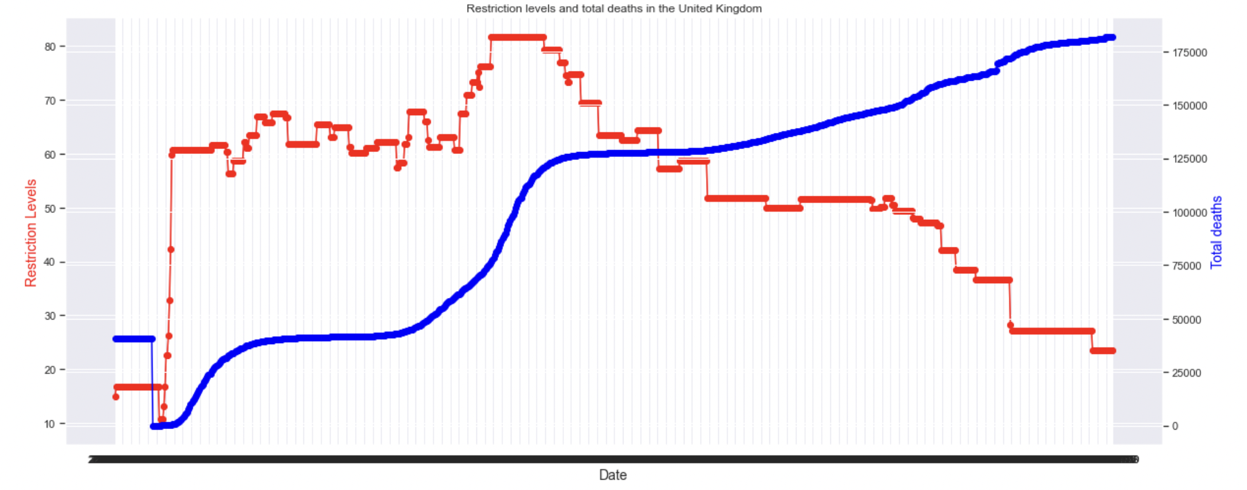
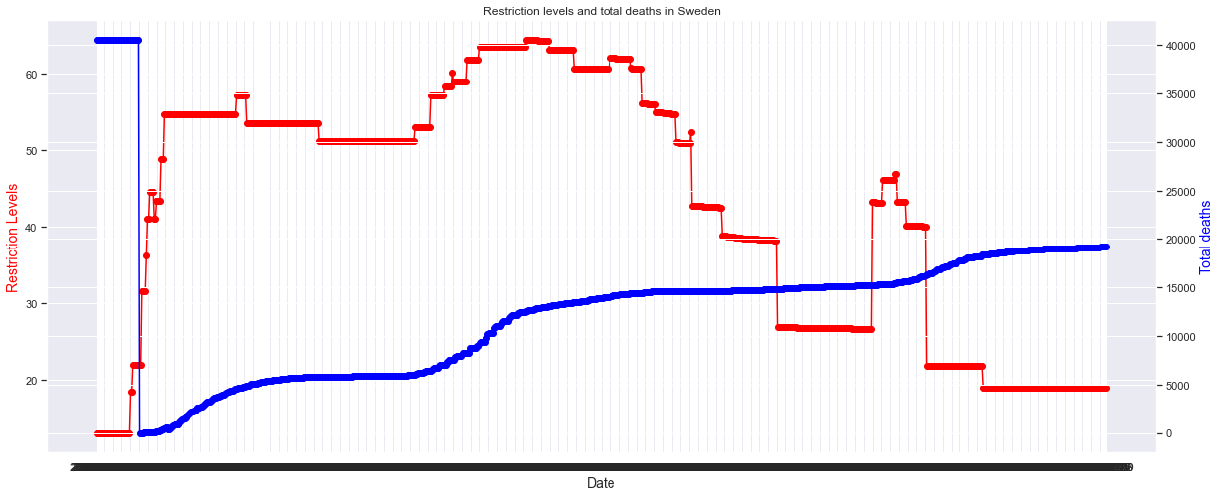
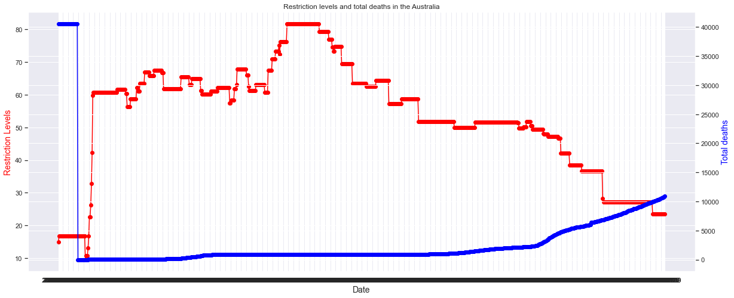
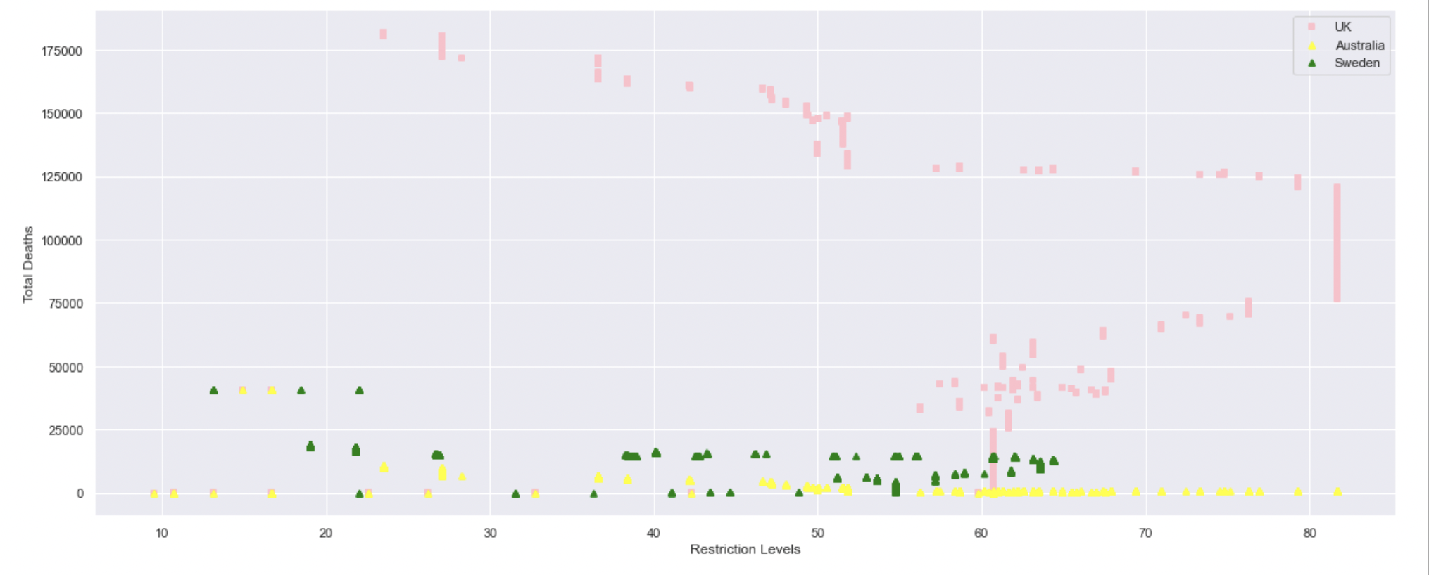
The effect of restrictions on total Covid deaths
United Kingdom
Sweden
Australia
Notes:
The first 3 graphs show that restrictions were stronger and stricter at the beginning of the pandemic and deaths were lower, the red line shows restriction levels and the blue line shows total deaths. The graph below shows a scatterplot comparing total deaths in all 3 countries with the restriction levels. The slight negative correlation, seen more obviously in data from Australia and Sweden shows that higher levels of restrictions are associated with lower deaths. The UK shows a more mixed picture but we can still see that there is some negative correlation.

Slide 8
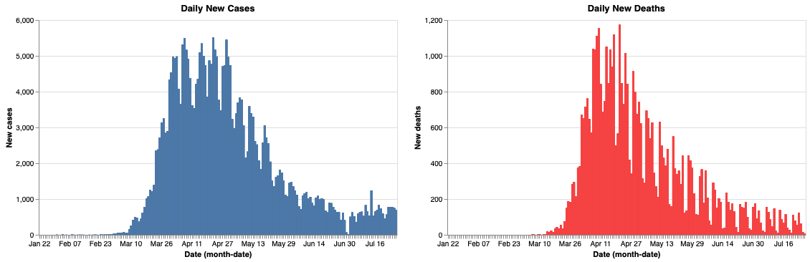
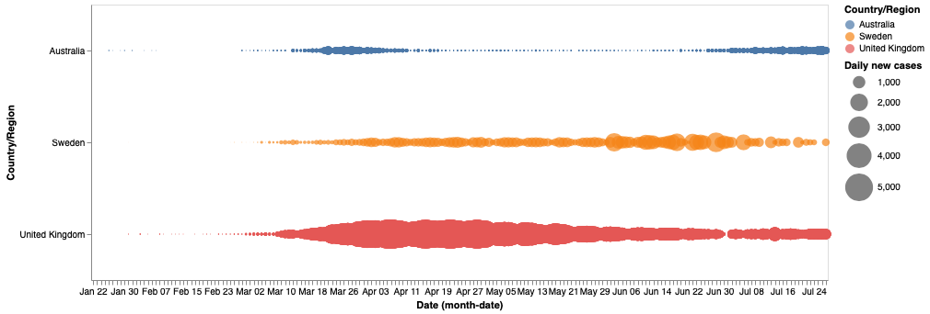
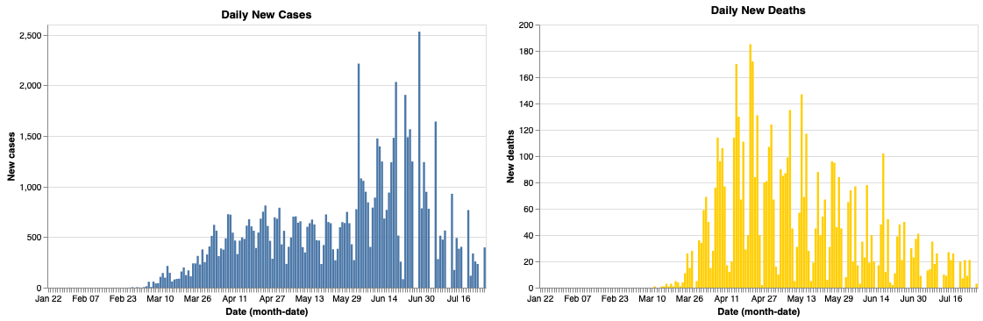
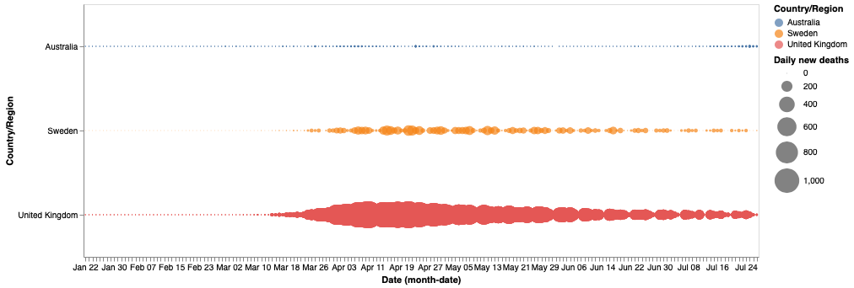
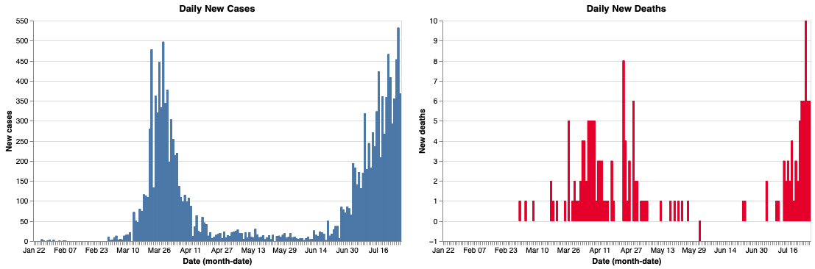
Projecting New Cases and Deaths on a daily Basis
Notes:
Altair is a declarative statistical visualisation library that employs the Vega and Vega-Lite grammars to describe the visual appearance and interactive behaviour of a visualisation in JSON format.
The key idea behind Altair is that you declare links between data columns and visual encoding channels (e.g., x and y axes, colour, size, etc.), and the library handles the rest of the visualisation process. As a result, you will have more time to concentrate on data and analysis rather than explaining how to visualise data.
New Covid19 cases have emerged in three countries: the United Kingdom, Australia, and Sweden.
Plotting each country’s new occurrences and deaths

Slide 9
Summary
Restriction Levels played a major role in reducing the deaths.
Restriction Levels played a major role in reducing the new Cases.
Sweden’s case is unique, could be attributed to Head Immunity.
Covid Analysis is still vital as new cases are still recorded to date.
ML can be used for forecasting.

